Slide 1
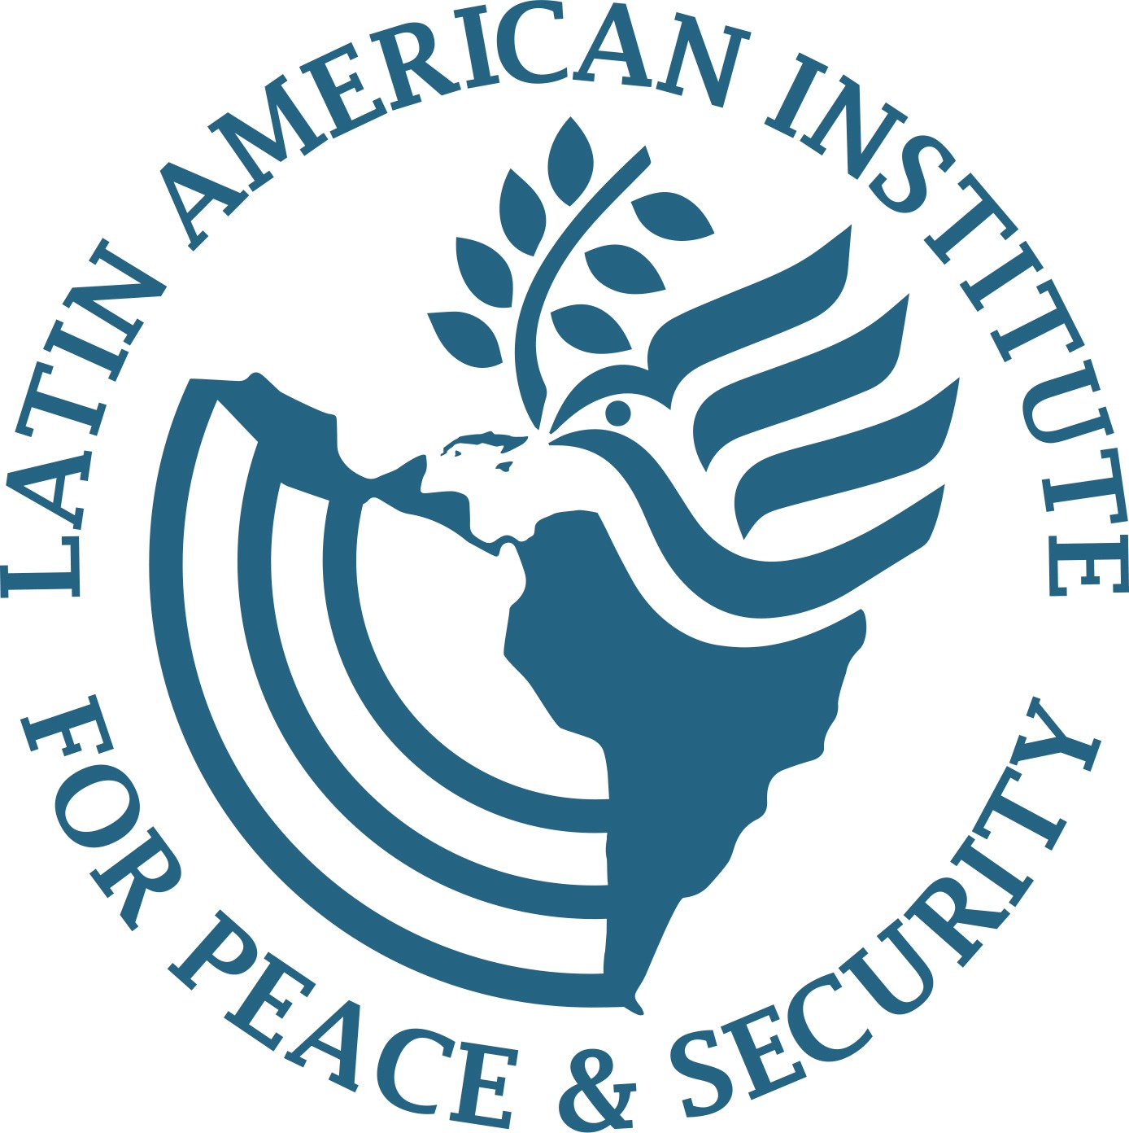
Enhancing Access to Transitional Justice Process Information with AI in Colombia
Steve Hege & Joshua Olave

Slide 2
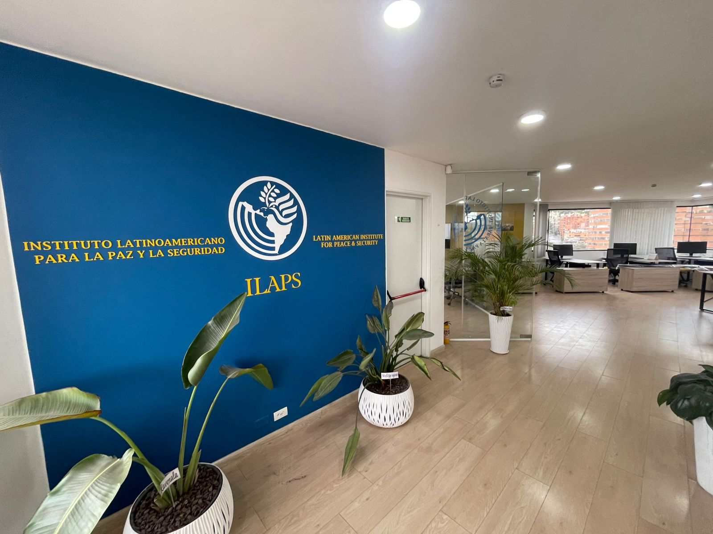

What is ILAPS?
Team of experienced senior expert advisers in peace negotiations, security sector reform, and transitional justice;
Based out of Bogotá, Colombia but with regional and global networks;
Recently founded on the legacy of the shuttered US Institute of Peace (USIP).

Slide 3
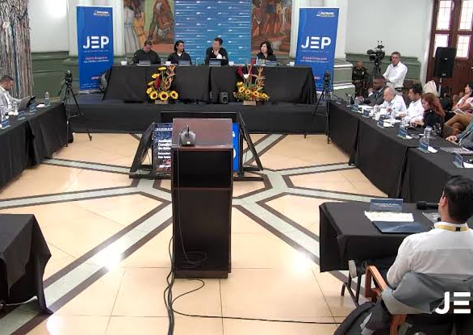
What is the Special Jurisdiction for Peace (JEP)?
The world's premier domestic court prosecuting war crimes and crimes against humanity from over six decades of armed conflict;
Combines both restorative and retributive approaches;
Established by the 2016 peace accord with the former FARC guerillas:
Only instance in modern history where an insurgent movement and the armed forces have both accepted to subject themselves to judicial prosecutions for atrocities.

Slide 4
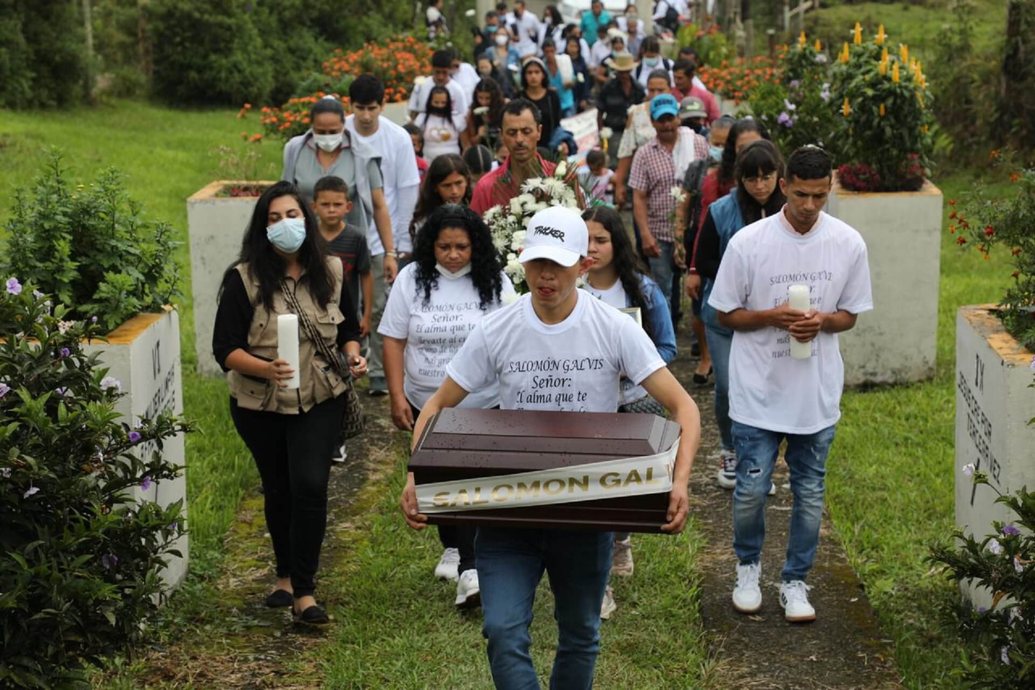
Current JEP Challenges
Growing public frustrations on inability to finalize complex investigations and issue sentences for eleven priority cases;
Mandated focus on systemic patterns of human rights violations in lieu of individual isolated cases;
Limited reach of ground-breaking public hearings with acknowledgements of responsibility by senior commanders on both sides;
Formal documents outlining charges, findings characterized by dense and complex language rendering inaccessible and incomprehensible to the more than 10 million registered victims with rights to truth and reparations.

Slide 5
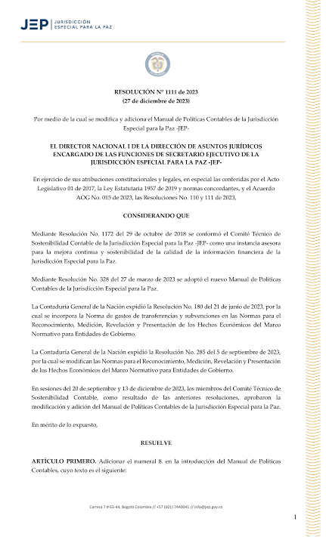
JEP Information Management
A total of 7,034 documents managed by the JEP’s outlining official decisions and findings amongst multiple chambers and 38 independent magistrates;
Summaries created for specialized technical audience prioritizing judicial officials;
Absence of specific macro case updates for perpetrators;
Media interpretations often driven by political polarization;
Significant concerns about witness and perpetrator protection amid ongoing armed conflict;
JEP is custodian of the Truth Commission’s reports and findings;

Slide 6
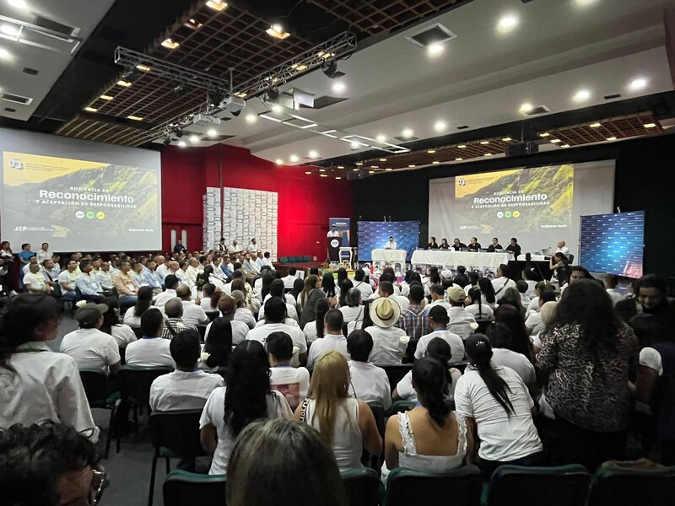
JEP Information Management
Massive repository of judgments, resolutions, bulletins, clarifications of votes, clarifications of sentences, and recusals;
Thousands of hours of official video from public hearings which are unsearchable;
Limited capacity for victim and community participation in the design of restorative sentencing projects for perpetrators;
Specialized lawyer interface required to understand developments in cases;

Slide 7
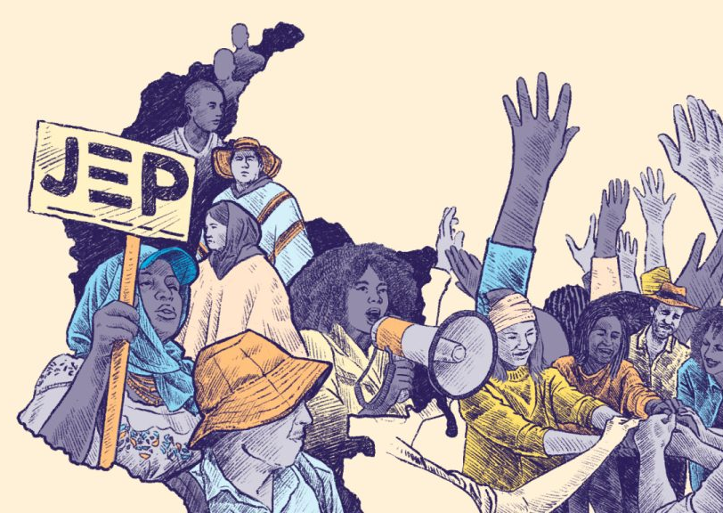
AI Tool Objective
Expand access to comprehensible information on specific incidents of human rights violations to satisfy victims with simple language adapted to Colombia’s diverse accents;
Summarize in simple language the enormous information repositories compiled through multiple complex databases unmatched by any conflict-affected country in modern history;
Provide clearer updates on cases and restorative sentencing projects to bolster favorable public opinion and direct participation;

Slide 8

Technical AI Design
Leverages sophisticated vector database architectures that transform complex legal documents and judicial databases into high-dimensional semantic representations
Preserves their contextual relationships while making them computationally searchable.

Slide 9
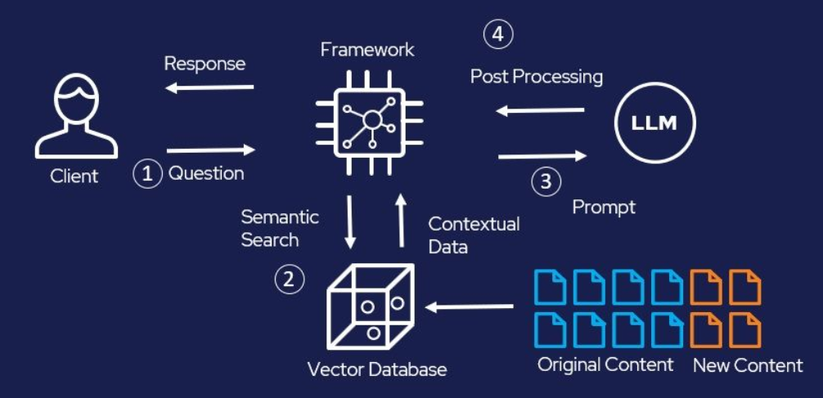
RAG Integration
Databases will be integrated with a Retrieval-Augmented Generation (RAG) framework that dynamically retrieves relevant document fragments in response to user queries and synthesize comprehensible, contextually appropriate responses.
Expand its vector database to include vast repositories from past truth commissions and other domestic transitional justice mechanisms.

Slide 10
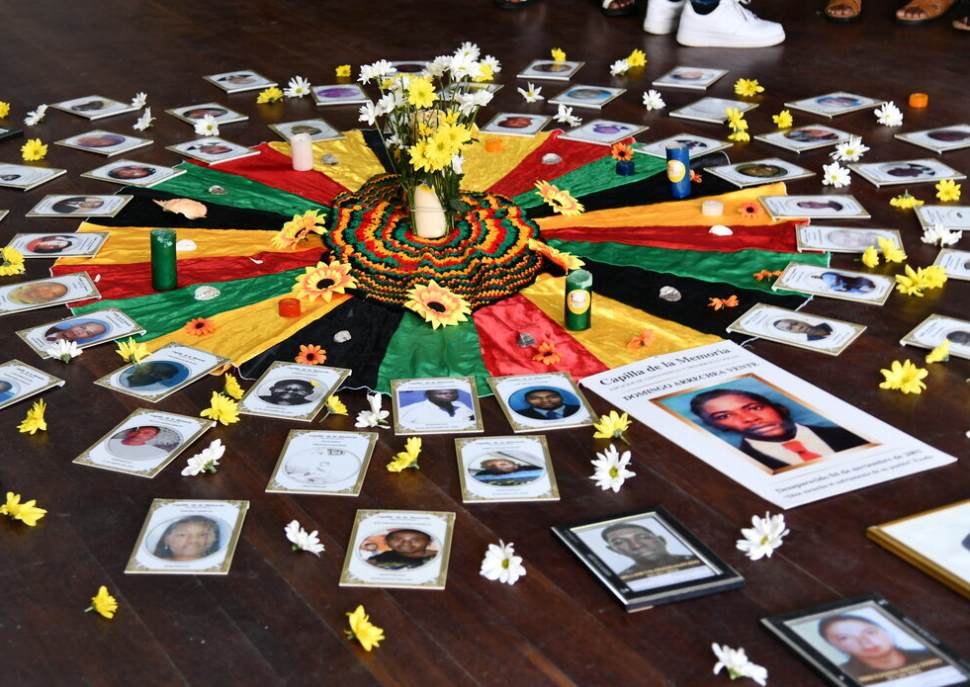
Conclusion: Current Challenges
Oral interface with multiple linguistic differences within sub-national regions;
Inclusion of non-judicial historical memory findings beyond the JEP;
Public outreach and presentation of the AI tool to conflict-affected communities;

